Slide 1
Greedy Algorithm
Course Code: CSC2211
Course Title: Algorithms
Dept. of Computer Science
Faculty of Science and Technology
Lecturer No: | 06 | Week No: | 06 | Semester:
Lecturer: | Name & email

Slide 2
Lecture Outline
Optimization Problem
Greedy Algorithm.
Coin Changing Problem.
Fractional knapsack Problem.
Huffman Encoding.
Activity Selection Problem.

Slide 3
Optimization Problems
An optimization problem is one in which you want to find, not just a solution, but the best solution
Example
Graph coloring optimization problem: given an undirected graph, G= (V,E), what is the minimum number of colors required to assign “colors” to each vertex in such a way that no two adjacent vertices have the same color
Path optimization problem: Find the shortest path(s) from u to v in a given graph G.
a
b
Find all the shortest paths from a to d:
a →b →d
a →c →d
d
c

Slide 4
Greedy Algorithm
Solves an optimization problem
For many optimization problems, greedy algorithm can be used. (not always)
Greedy algorithm for optimization problems typically go through a sequence of steps, with a set of choices at each step. Current choice does not depend on evaluating potential future choices or pre-solving repeatedly occurring subproblems (a.k.a., overlapping subproblems). With each step, the original problem is reduced to a smaller problem.
Greedy algorithm always makes the choice that looks best at the moment.
It makes a locally optimal choice in the hope that this choice will lead to a globally optimal solution.

Slide 5
Optimal Solution
What is an Optimal Solution?
Given a problem, more than one solution exist
One of the solution is the best based on some given constraints, that solution is called the optimal solution
What is Global Optimal Solution?
Optimal Solution to the main problem
What is local Optimal Solution?
Optimal Solution to the sub-problems

Slide 6
Example of Greedy Algorithms
Coin Changing Problem
Fractional Knapsack Problem
Activity Selection Problem
Job Scheduling Problem
Dijkstra’s Shortest Path Problem
Minimum Spanning Tree Problem

Slide 7
Greedy algorithms
Coin changing problem
Definition
Given coin denominations in {C }, make change for a given amount
A with the minimum number of coins.
Example:
Coin denominations, C = {25,10,5,1} Amount to change, A = 73
Choose 2, 25 coins, so remaining is 73 − 2 ∗25 = 23
Choose 2, 10 coins, so remaining is 23 − 2 ∗10 = 3
Choose 0, 5 coins, so remaining is 3
Choose 3, 1 coins, so remaining is 3 − 1 ∗3 = 0
Solution (and it’s optimal): 2 × 25 + 2 × 10 + 3 × 1 = 73, total 7 coins
Key Question
Does a greedy approach always produce the optimal solution?
34 / 38

Slide 8
Coin changing problem (continued)
Coin denominations, C = {12, 5, 1} Amount to change, A = 15
Example (using greedy strategy)
Choose 1, 12 coins, so remaining is 15 − 1 ∗12 = 3
Choose 3, 1 coins, so remaining is 3 − 1 ∗ 3 = 0
Solution: 4 coins.
Example (using optimal strategy)
Choose 0, 12 coins, so remaining is 15
Choose 3, 5 coins, so remaining is 15 − 3 ∗ 5 = 0
Solution: 3 coins.
So, greedy strategy does not provide a general solution to this problem!
35 / 38

Slide 9
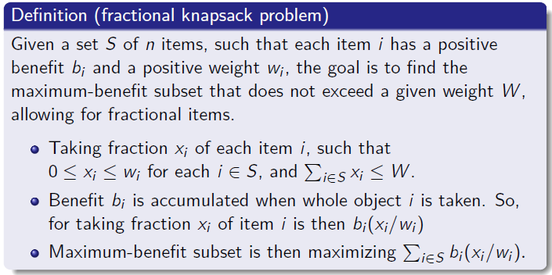
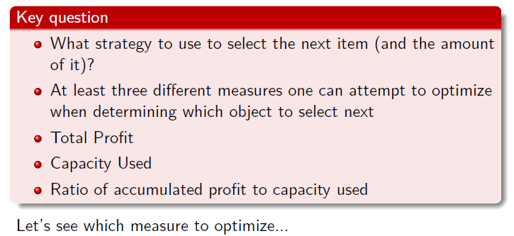
Fractional knapsack problem
24 / 38

Slide 10
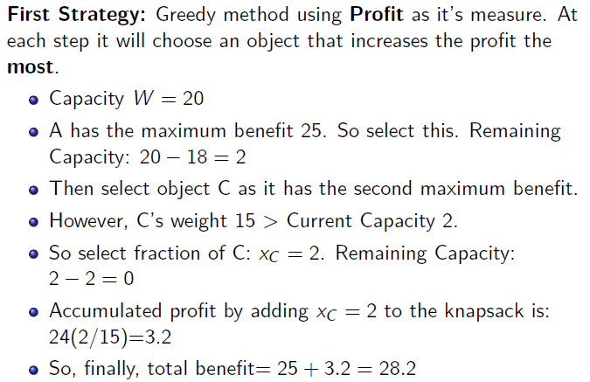
Fractional knapsack problem
Item | Benefit | Weight
A | 25 | 18 kg
B | 15 | 10 kg
C | 24 | 15 kg
Capacity W=20

Slide 11
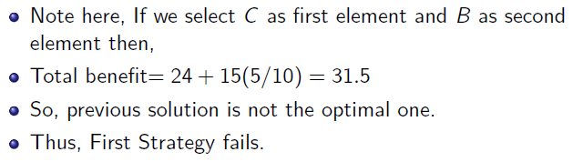
Fractional knapsack problem
Item | Benefit | Weight
A | 25 | 18 kg
B | 15 | 10 kg
C | 24 | 15 kg
27 / 38

Slide 12
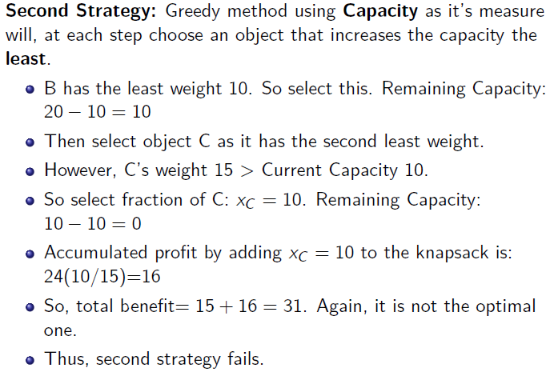
Fractional knapsack problem
28 / 38

Slide 13
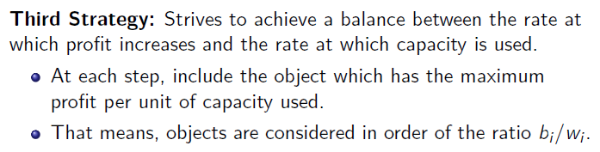
Fractional knapsack problem

Slide 14
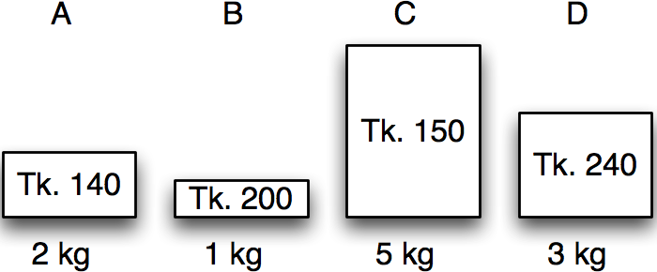
Greedy algorithms
Fractional knapsack in action
Item | Benefit | Weight
A | 140 | 2 kg
B | 200 | 1 kg
C | 150 | 5 kg
D | 240 | 3 kg
Calculate benefit/kg – the value index.

Slide 15
Greedy algorithms
Fractional knapsack in action
Item | Benefit | Weight | Value index
A | 140 | 2 kg | 70
B | 200 | 1 kg | 200
C | 150 | 5 kg | 30
D | 240 | 3 kg | 80
Sort by non-increasing value index.
Licensed under
30 / 38

Slide 16
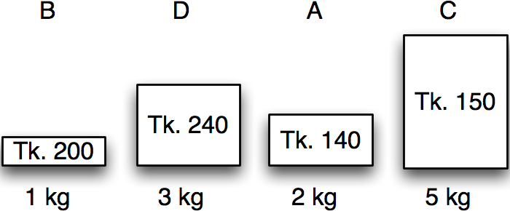
Greedy algorithms
Fractional knapsack in action
Item | Benefit | Weight | Value index
B | 200 | 1 kg | 200
D | 240 | 3 kg | 80
A | 140 | 2 kg | 70
C | 150 | 5 kg | 30
Maximum weight:
5 kg
30 / 38

Slide 17
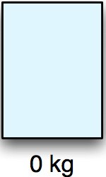
Greedy algorithms
Fractional knapsack in action
Item | Benefit | Weight | Value index | Chosen
B | 200 | 1 kg | 200 | 0 kg
D | 240 | 3 kg | 80 | 0 kg
A | 140 | 2 kg | 70 | 0 kg
C | 150 | 5 kg | 30 | 0 kg
Maximum weight:
5 kg
Remaining:
5 kg
Benefit:
0 kg
30 / 38

Slide 18
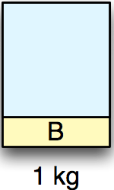
Greedy algorithms
Fractional knapsack in action
Item | Benefit | Weight | Value index | Chosen
B | 200 | 1 kg | 200 | 1 kg
D | 240 | 3 kg | 80 | 0 kg
A | 140 | 2 kg | 70 | 0 kg
C | 150 | 5 kg | 30 | 0 kg
Maximum weight:
5 kg
Remaining:
4 kg
Benefit:
200 kg
30 / 38

Slide 19
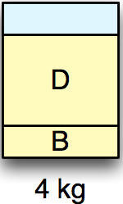
Greedy algorithms
Fractional knapsack in action
Item | Benefit | Weight | Value index | Chosen
B | 200 | 1 kg | 200 | 1 kg
D | 240 | 3 kg | 80 | 3 kg
A | 140 | 2 kg | 70 | 0 kg
C | 150 | 5 kg | 30 | 0 kg
Maximum weight:
5 kg
Remaining:
1 kg
Benefit:
440 kg
30 / 38

Slide 20
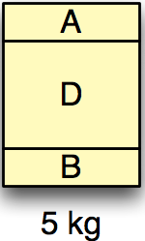
Greedy algorithms
Fractional knapsack in action
Item | Benefit | Weight | Value index | Chosen
B | 200 | 1 kg | 200 | 1 kg
D | 240 | 3 kg | 80 | 3 kg
A | 140 | 2 kg | 70 | 1 kg
C | 150 | 5 kg | 30 | 0 kg
Maximum weight:
5 kg
Remaining:
0 kg
Benefit:
510 Tk.
30 / 38

Slide 21
Greedy algorithms
Fractional knapsack in action
Item | Benefit | Weight | Value index | Chosen
B | 200 | 1 kg | 200 | 1 kg
D | 240 | 3 kg | 80 | 3 kg
A | 140 | 2 kg | 70 | 1 kg
C | 150 | 5 kg | 30 | 0 kg
Maximum weight:
5 kg
Remaining:
0 kg
Benefit:
510 Tk.
30 / 38

Slide 22
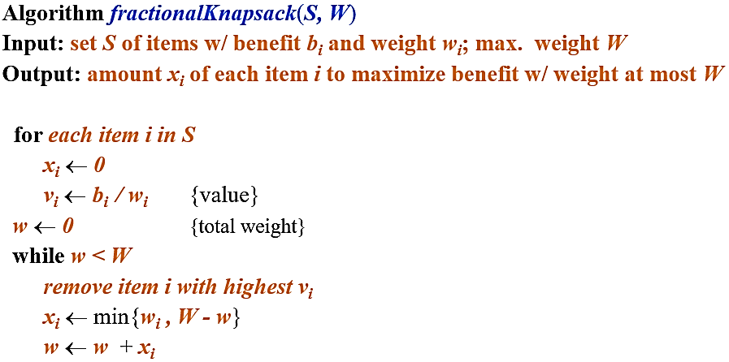
Fractional knapsack greedy algorithm

Slide 23
Fractional knapsack algorithm
Running time:
Given a collection S of n items, such that each item i has a benefit b_{i} and weight w_{i}, we can construct a maximum-benefit subset of S, allowing for fractional amounts, that has a total weight W in O(nlogn) time. (how?)
Use heap-based priority queue to store S
Removing the item with the highest value takes O(logn) time
In the worst case, need to remove all items

Slide 24
Exercise
Assume that we have a knapsack with max weight capacity, W = 16. our objective is to fill the knapsack with items such that the benefit (value or profit) is maximum. Consider the following items and their associated weight and value
ITEM | WEIGHT | VALUE
i1 | 6 | 6
i2 | 10 | 2
i3 | 3 | 1
i4 | 5 | 8
i5 | 1 | 3
i6 | 3 | 5

Slide 25
Huffman Codes
Widely used technique for data compression
Assume the data to be a sequence of characters
Looking for an effective way of storing the data
Binary character code
Uniquely represents a character by a binary string

Slide 26
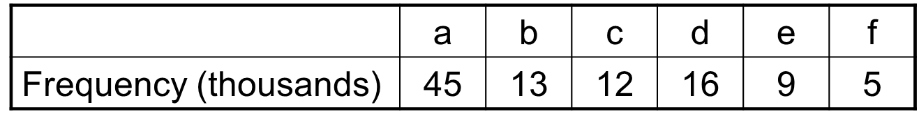
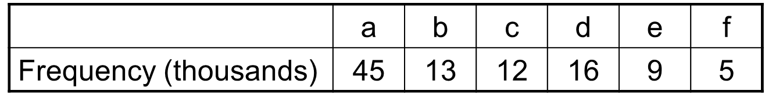
Fixed-Length Codes
E.g.: Data file containing 100,000 characters
3 bits needed
a = 000, b = 001, c = 010, d = 011, e = 100, f = 101
Requires: 100,000 ⋅ 3 = 300,000 bits
Idea: Use the frequencies of occurrence of characters to build a optimal way of representing each character

Slide 27
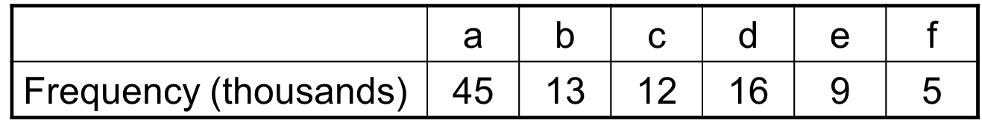
Variable-Length Codes
E.g.: Data file containing 100,000 characters
Assign short codewords to frequent characters and long codewords to infrequent characters
a = 0, b = 101, c = 100, d = 111, e = 1101, f = 1100
(45 ⋅ 1 + 13 ⋅ 3 + 12 ⋅ 3 + 16 ⋅ 3 + 9 ⋅ 4 + 5 ⋅ 4)⋅ 1,000
= 224,000 bits

Slide 28
Prefix Codes
Prefix codes: A prefix code is a type of code system distinguished by its possession of the "prefix property", which requires that there is no whole code word in the system that is a prefix (initial segment) of any other code word in the system.
Codes of a code word cannot be prefix of some other code word. Better name would be “prefix-free codes”
We can achieve optimal data compression using prefix codes
We will restrict our attention to prefix codes

Slide 29
Encoding with Binary Character Codes
Encoding
Concatenate the code words representing each character in the file
E.g.:
a = 0, b = 101, c = 100, d = 111, e = 1101, f = 1100
abc = 0 ⋅ 101 ⋅ 100 = 0101100

Slide 30
Decoding with Binary Character Codes
Prefix codes simplify decoding
No codeword is a prefix of another ⇒ the codeword that begins an encoded file is unambiguous
Approach
Identify the initial codeword
Translate it back to the original character
Repeat the process on the remainder of the file
E.g.:
a = 0, b = 101, c = 100, d = 111, e = 1101, f = 1100
001011101 = 0.0.101.1101 = aabe

Slide 31

Constructing a Huffman Code
A greedy algorithm that constructs an optimal prefix code called a Huffman code
Assume that:
C is a set of n characters
Each character has a frequency f(c)
The tree T is built in a bottom-up manner
Left means ‘0’, right means ‘1’
More frequent characters will be higher in the tree
Idea:
Start with a set of |C| leaves
At each step, merge the two least frequent objects: the frequency of the new node = sum of two frequencies
Use a min-priority queue Q, keyed on f to identify the two least frequent objects

Slide 32
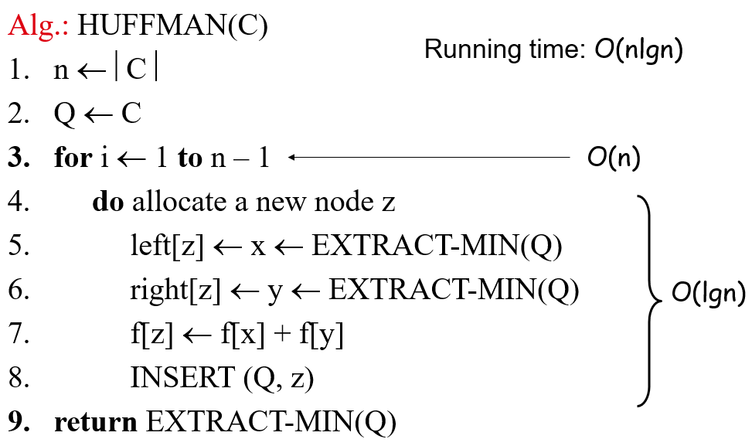
Constructing a Huffman tree

Slide 33
Example
f: 5
e: 9
c: 12
b: 13
d: 16
a: 45
c: 12
b: 13
14
d: 16
a: 45
0
1
f: 5
e: 9
14
d: 16
25
a: 45
25
30
a: 45
0
1
0
1
0
1
0
1
f: 5
e: 9
c: 12
b: 13
c: 12
b: 13
14
d: 16
0
1
f: 5
e: 9
55
0
100
1
a: 45
1
0
a: 45
55
25
30
0
1
0
1
0
1
25
30
c: 12
b: 13
14
d: 16
0
1
0
1
0
1
c: 12
b: 13
14
d: 16
f: 5
e: 9
0
1
f: 5
e: 9

Slide 34
Huffman encoding/decoding using Huffman tree
Encoding:
Construct Huffman tree using the previous algorithm
Traverse the Huffman tree to assign a code to each leaf (representing an input character )
Use these codes to encode the file
Decoding:
Construct Huffman tree using the previous algorithm
Traverse the Huffman tree according to the bits you encounter until you reach a leaf node at which point you output the character represented by that leaf node.
Continue in this fashion until all the bits in the file are read.

Slide 35
Activity-Selection Problem
Problem: get your money’s worth out of a festival
Buy a wristband that lets you onto any ride
Lots of rides, each starting and ending at different times
Your goal: ride as many rides as possible
Another, alternative goal that we don’t solve here: maximize time spent on rides
Welcome to the activity selection problem

Slide 36
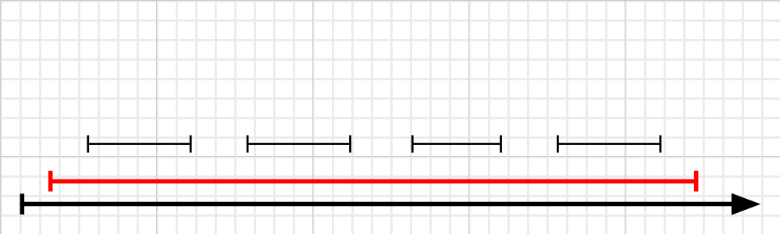
Strategy 1:tegy 1. Earliest First
The idea is to start using the resource as early as possible.
1. Sort the activities by starting time, breaking ties arbitrarily.
2. Pick the first one, removing it from the list along with all the activities that conflict with it.
3. Repeat Step 2, until the list is empty.
Number Of Activity = 1
This strategy does not lead to an optimal solution.

Slide 37
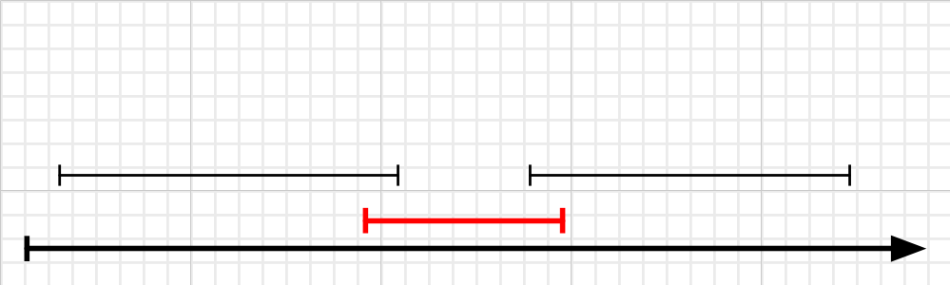
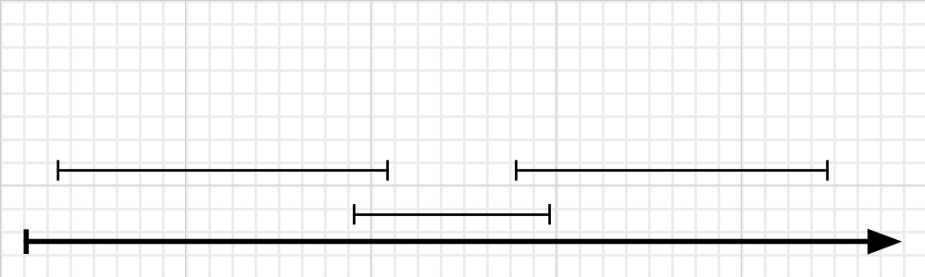
Strategy 2:tegy 1. Earliest First
The idea is to start shortest activity.
1. Sort the activities by length, breaking ties arbitrarily.
2. Pick the first one, removing it from the list along with all the activities that conflict with it.
Repeat Step 2, until the list is empty.
Number Of Activity = ?
Number Of Activity = 1
This strategy does not lead to an optimal solution.

Slide 38
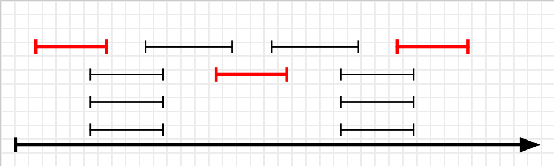
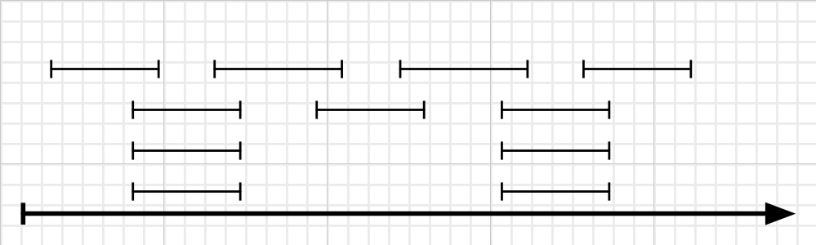
Strategy 3:tegy 1. Earliest First
The idea is to start with least-conflict activity.
Strategy 3. Least-conflict First
The Shortest First strategy failed perhaps because the shorter ones had more conflicts, and ruled out too many activities in the process.
1. Sort the activities by the number of other activities which conflict with it.
2. Pick the first one, removing it from the list along with all the activities that conflict with it.
3. Repeat Step 2, until the list is empty.
|A| =?SE 221: Algorithms
|A| = 3.
CSE 221: Algorithms
This strategy does not lead to an optimal solution.

Slide 39
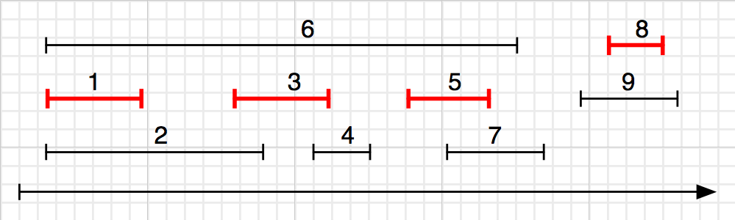
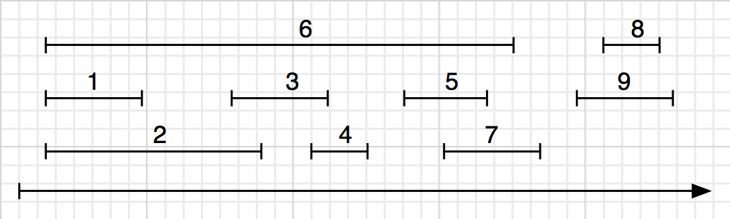
Strategy 4:tegy 1. Earliest First
The idea is to start with finish-first activity.
1. Sort the activities by finishing time, breaking ties arbitally.
2. Pick the first one, removing it from the list along with all the activities that conflict with it.
3. Repeat Step 2, until the list is empty.
|A| =?SE 221: Algorithms
|A| = 4.
CSE 221: Algorithms
This strategy is the one that works.

Slide 40
Example
Here are a set of start and finish times
i | 1 | 2 | 3 | 4 | 5 | 6 | 7 | 8 | 9 | 10 | 11
S_{j} | 1 | 5 | 0 | 3 | 6 | 5 | 3 | 12 | 8 | 2 | 8
f_{j} | 4 | 7 | 6 | 5 | 10 | 9 | 9 | 16 | 12 | 14 | 11
Sorted according to finishing time
i | 1 | 2 | 3 | 4 | 5 | 6 | 7 | 8 | 9 | 10 | 11
S_{j} | 1 | 3 | 0 | 5 | 3 | 5 | 6 | 8 | 8 | 2 | 12
f_{j} | 4 | 5 | 6 | 7 | 9 | 9 | 10 | 11 | 12 | 14 | 16
{1, 4, 8, 11} which is a larger set (an optimal solution)
Solution is not unique, consider {2, 4, 9, 11} (another optimal solution)

Slide 41
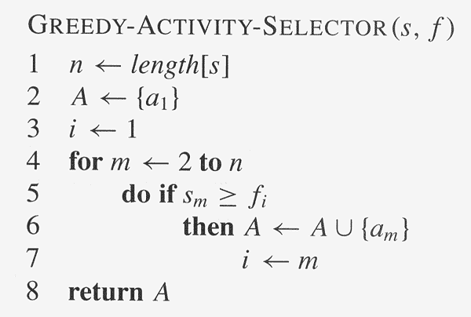
Activity selection Algorithm

Slide 42
Exercise
Input: A list of different activities with starting and ending times.
{(5,9), (1,2), (3,4), (0,6), (5,7), (8,9)}
Use greedy algorithm to do maximum number of activities.

Slide 43
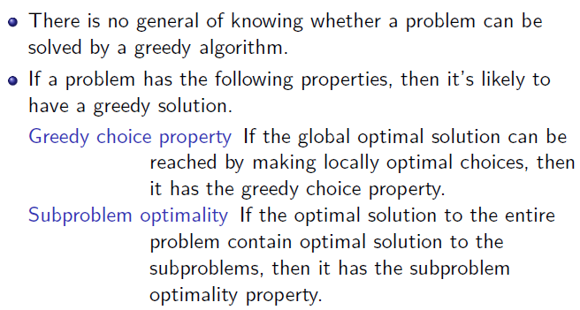
Problem types solved by greedy algorithms

Slide 44
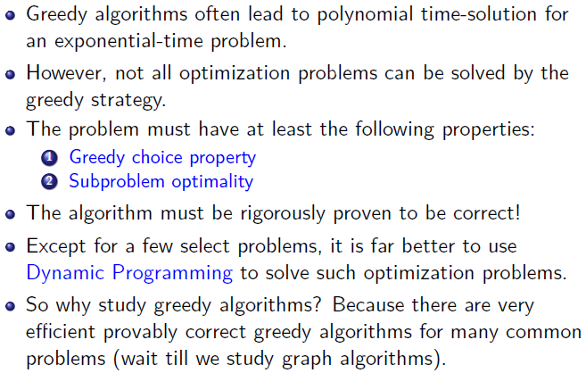
Conclusion
38 / 38

Slide 45
Books
Introduction to Algorithms, Thomas H. Cormen, Charle E. Leiserson,
Ronald L. Rivest, Clifford Stein (CLRS).
Fundamental of Computer Algorithms, Ellis Horowitz, Sartaj Sahni, Sanguthevar Rajasekaran (HSR)

Slide 46
References
https://www.tutorialspoint.com/data_structures_algorithms/greedy_algorithms.htm
https://www.geeksforgeeks.org/fractional-knapsack-problem/
https://www.geeksforgeeks.org/activity-selection-problem-greedy-algo-1/
https://www.tutorialspoint.com/Huffman-Coding-Algorithm
https://www.geeksforgeeks.org/huffman-coding-greedy-algo-3/

